Slide 1
Variant Calling
O. Harismendy, PhD
CMM262 – W2020

Slide 2
Single sample calling
FASTQ
BAM
VCF

Slide 3
Single sample calling
FASTQ
BAM
VCF
Group / joint calling
FASTQ
BAM
FASTQ
BAM
VCF
FASTQ
BAM
FASTQ
BAM

Slide 4
Single sample calling
FASTQ
BAM
VCF
Group / joint calling
FASTQ
BAM
BAM
FASTQ
BAM
Group re-alignment
BAM
VCF
FASTQ
BAM
BAM
FASTQ
BAM
BAM

Slide 5
Single sample calling
FASTQ
BAM
VCF
Group / joint calling
FASTQ
BAM
“group VCF”
gVCF
FASTQ
BAM
VCF
FASTQ
BAM
gVCF
FASTQ
BAM

Slide 6
Multi-step analysis

Slide 7


Slide 8
SAMTOOLS
Manipulate alignments in the BAM format
imports from and exports to the SAM (Sequence Alignment/Map) format
sorting
merging
indexing
retrieve reads in any regions
Works on a stream. Commands combined with Unix pipes.
Able to open a BAM on a remote FTP or HTTP server
http://www.htslib.org

Slide 9
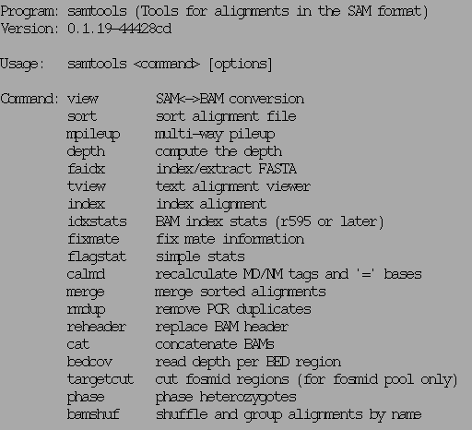
SAMTOOLS examples
http://www.htslib.org

Slide 10
SAMTOOLS view
Usage: samtools view [options] <in.bam>|<in.sam> [region1 [...]]
Options: -b output BAM
-h print header for the SAM output
-H print header only (no alignments)
-S input is SAM
-u uncompressed BAM output (force -b)
-1 fast compression (force -b)
-x output FLAG in HEX (samtools-C specific)
-X output FLAG in string (samtools-C specific)
-c print only the count of matching records
-B collapse the backward CIGAR operation
-@ INT number of BAM compression threads [0]
-L FILE output alignments overlapping the input BED FILE [null]
-t FILE list of reference names and lengths (force -S) [null]
-T FILE reference sequence file (force -S) [null]
-o FILE output file name [stdout]
-R FILE list of read groups to be outputted [null]
-f INT required flag, 0 for unset [0]
-F INT filtering flag, 0 for unset [0]
-q INT minimum mapping quality [0]
-l STR only output reads in library STR [null]
-r STR only output reads in read group STR [null]
-s FLOAT fraction of templates to subsample; integer part as seed [-1]
-? longer help
http://www.htslib.org

Slide 11
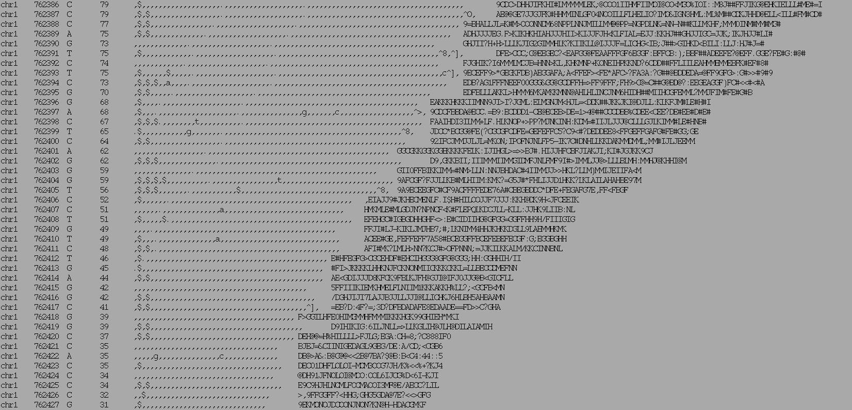
SAMTOOLS Pileup
Chrom
Ref
Read bases
Qualities
Position
Coverage

Slide 12
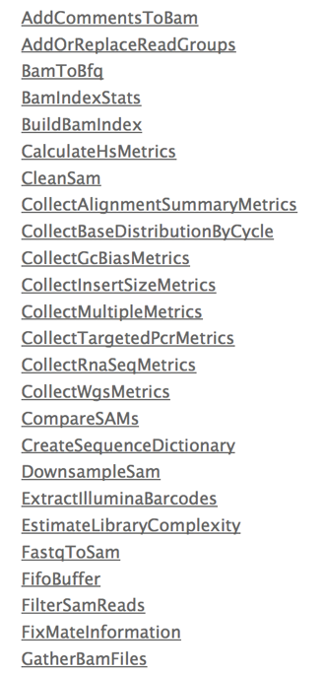
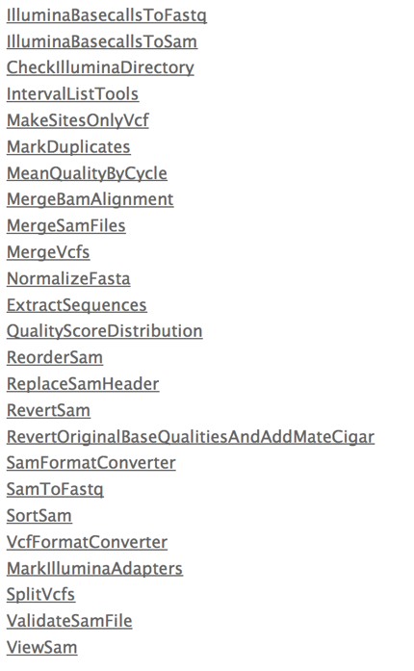
Picard – the other tool box
http://picard.sourceforge.net/

Slide 13
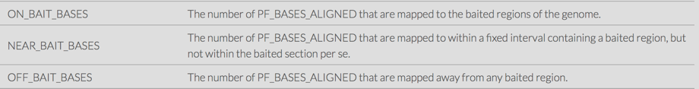
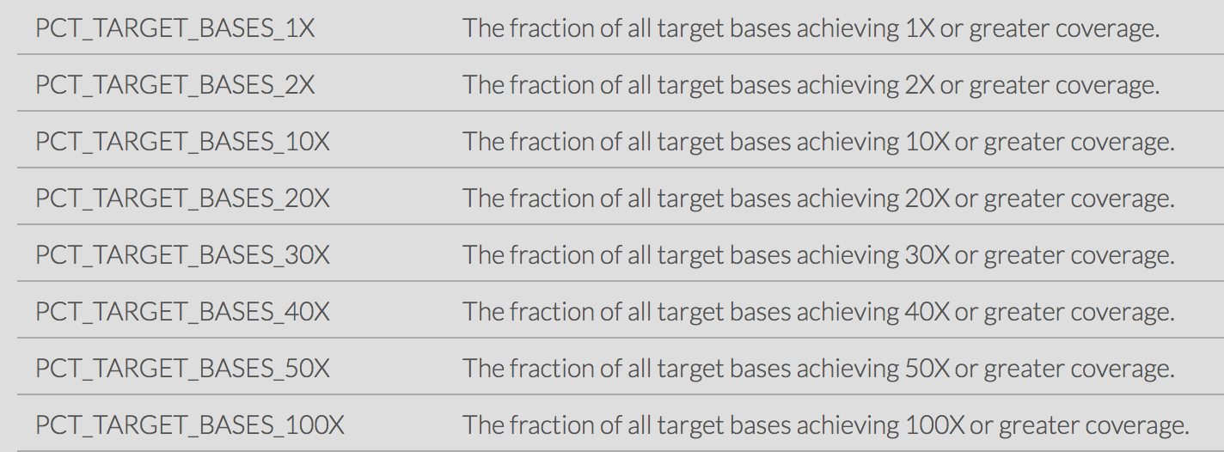
Picard Hs Metrics
Dedicated to targeted sequencing

Slide 14
Alignment REFINEMENT
BAM postprocessing

Slide 15
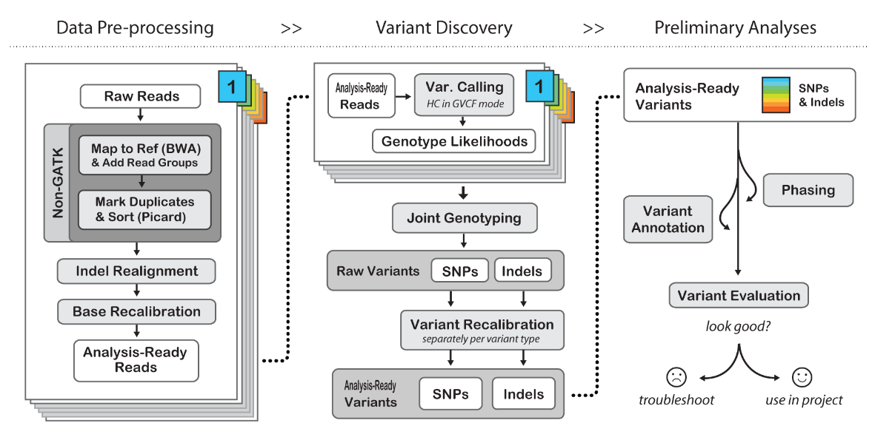
GATK Best Practice

Slide 16
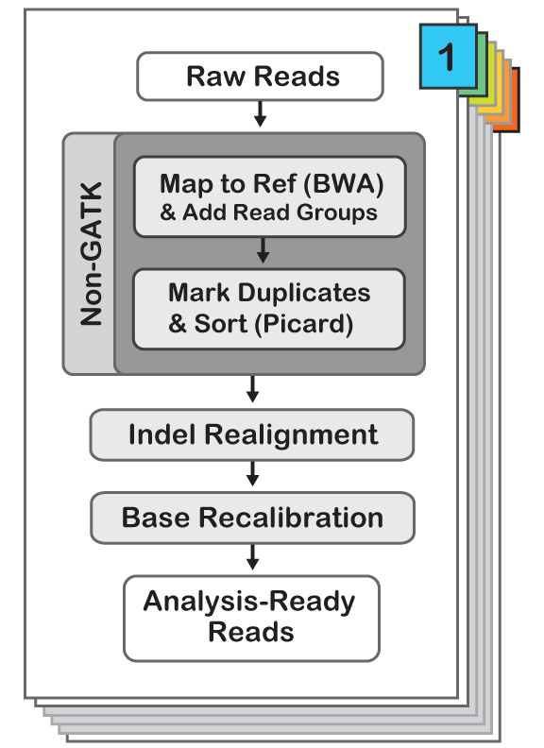

Slide 17
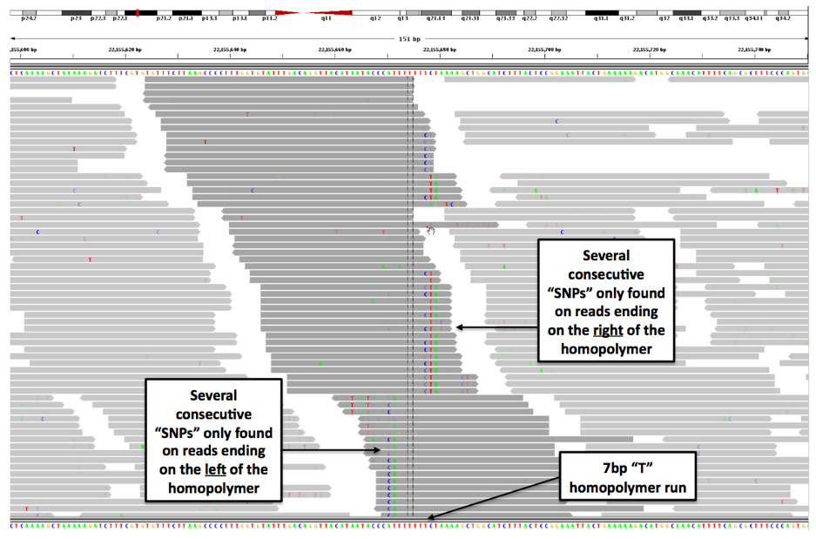
INDEL Realignment
The problem

Slide 18
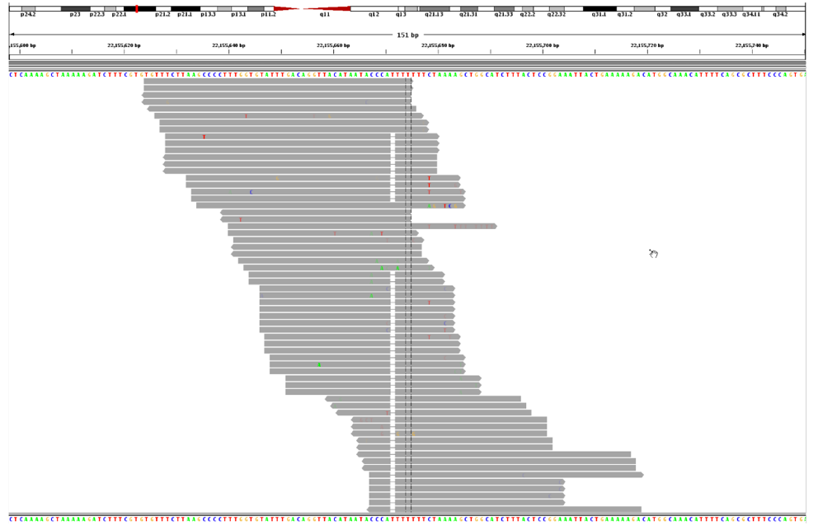
INDEL Realignment
The problem

Slide 19
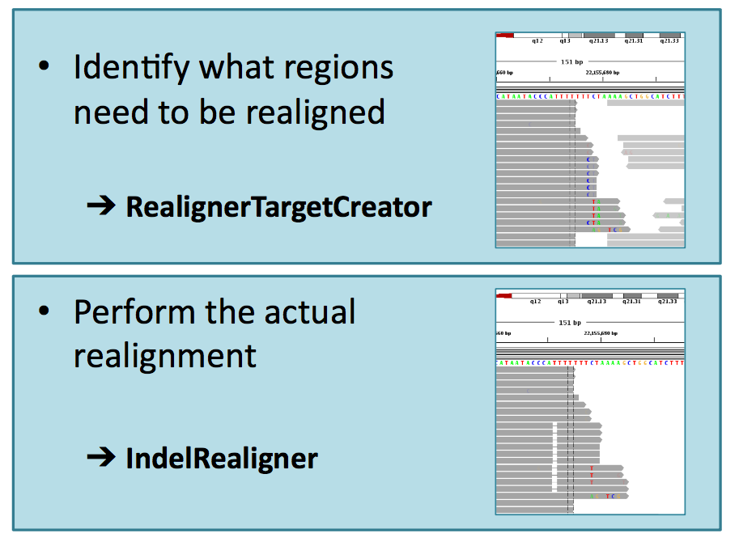
INDEL Realignment
The solution

Slide 20
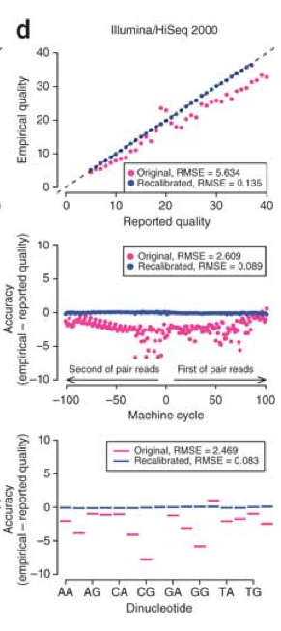
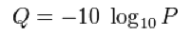
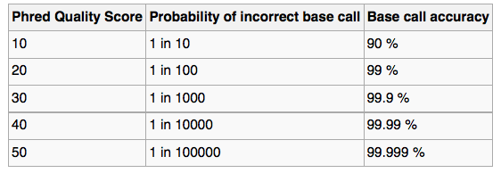
Base Quality Recalibration
DePristo et al (2011)

Slide 21
ALIGNMENT VISUALISATION

Slide 22
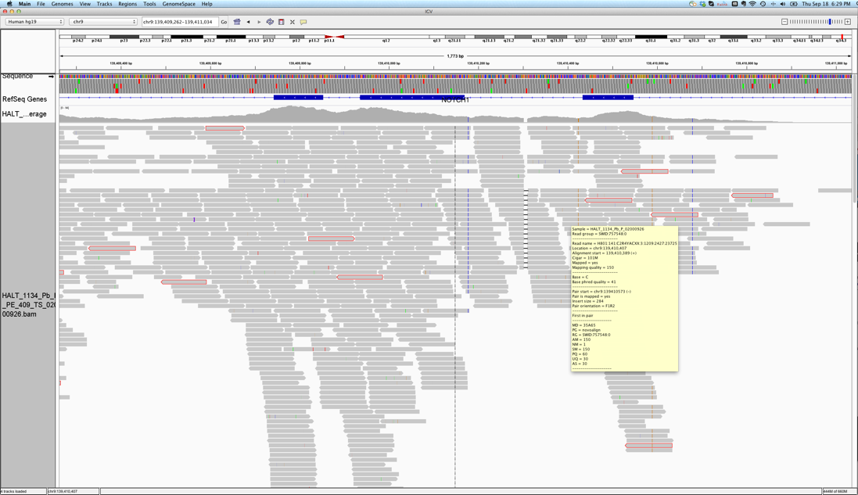
Integrative Genome Viewer
http://www.broadinstitute.org/software/igv/

Slide 23
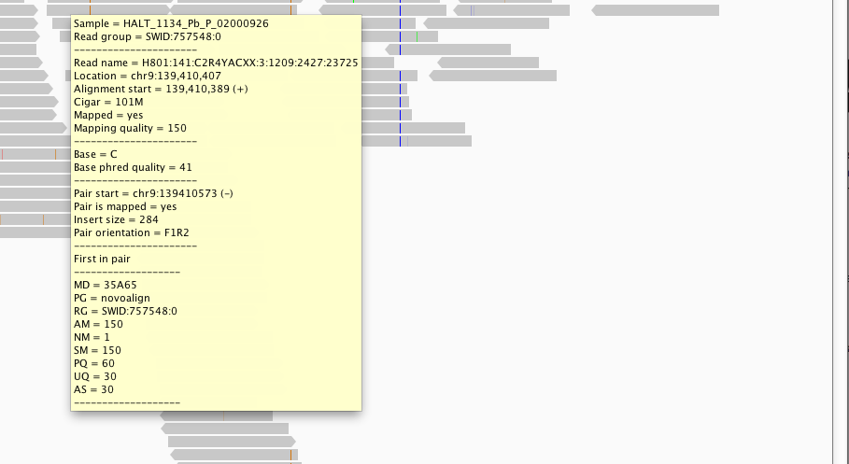
Integrative Genome Viewer
http://www.broadinstitute.org/software/igv/

Slide 24
SNV Calling
GATK/VARSCAN

Slide 25
GATK Haplotype Caller

Slide 26
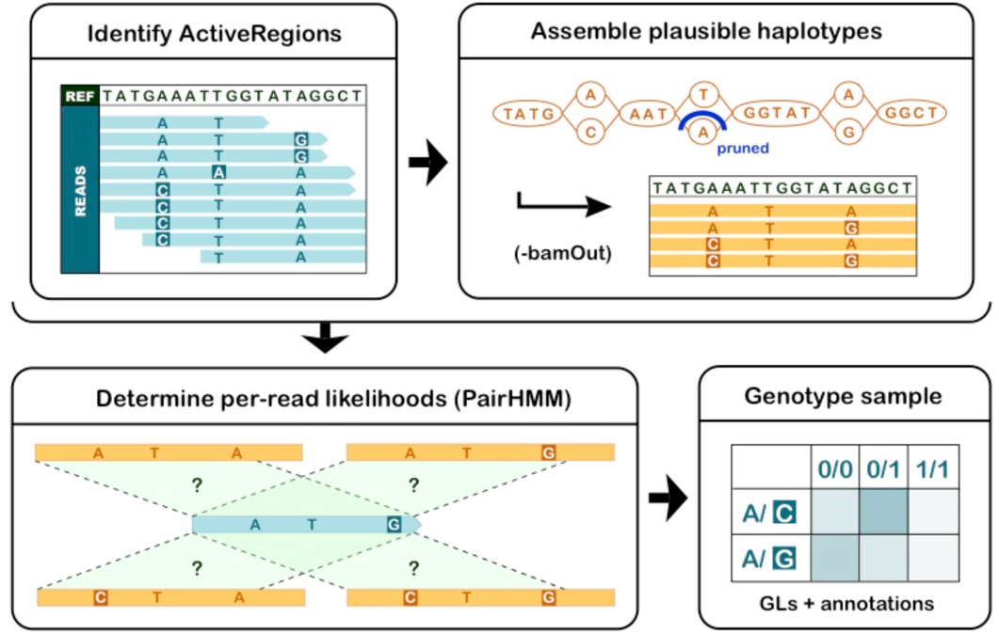
GATK Haplotype Caller

Slide 27
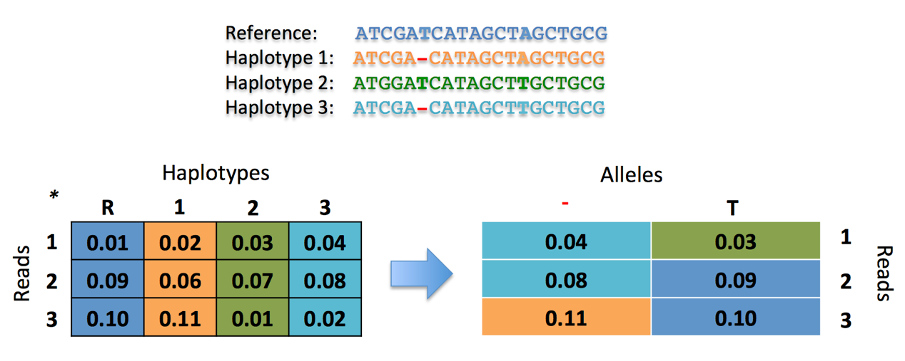
GATK Haplotype Caller
Haplotypes > Alleles

Slide 28
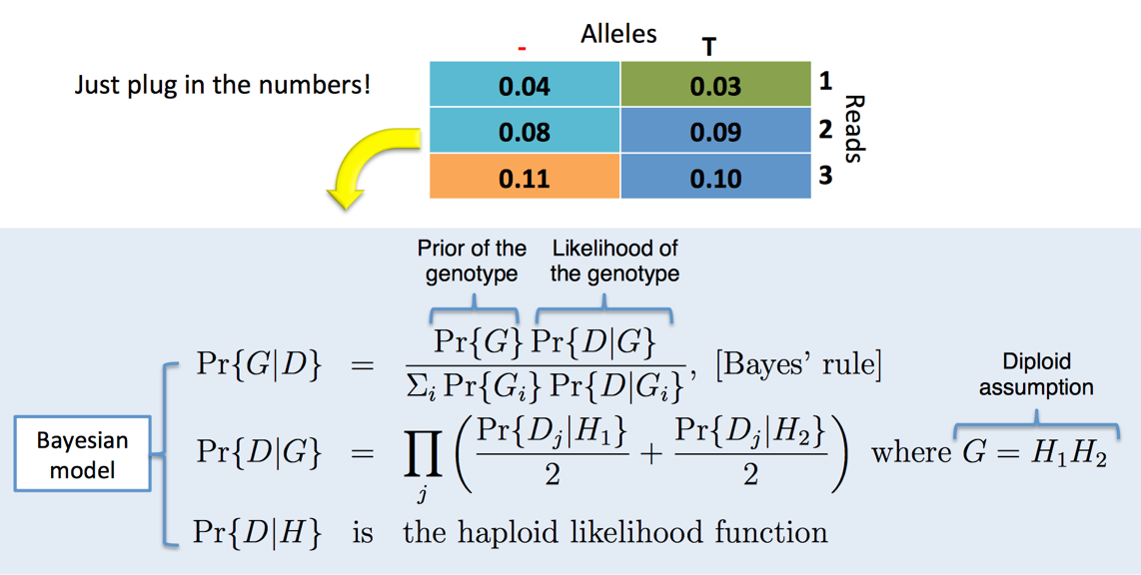
GATK Haplotype Caller
Alleles > Genotype Probabilities

Slide 29
Mutect2

Slide 30
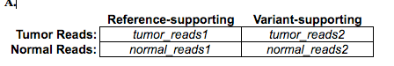
Varscan
Compare Normal and Tumor directly
Results
Germline: Present in both
Somatic: Present in Tumor only
Loss of Heterozygosity: Missed Het in the tumor
Fisher Exact test
Kobolt et al. (2012)

Slide 31
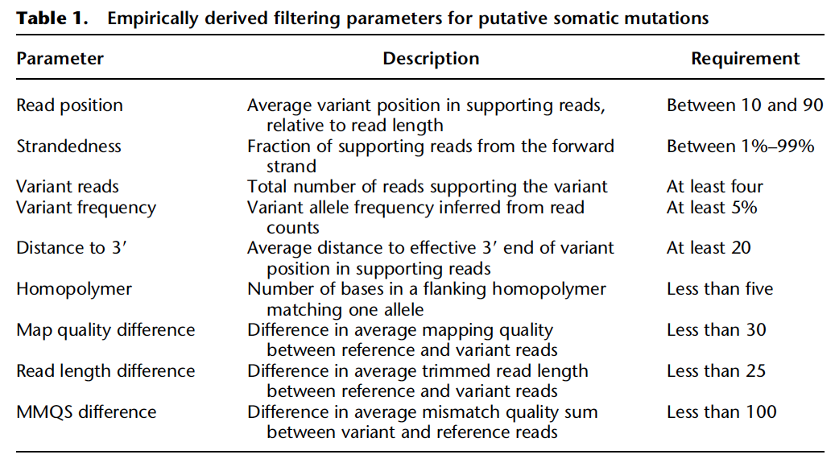
Heuristic Filters

Slide 32
Variant ANALYSIS

Slide 33
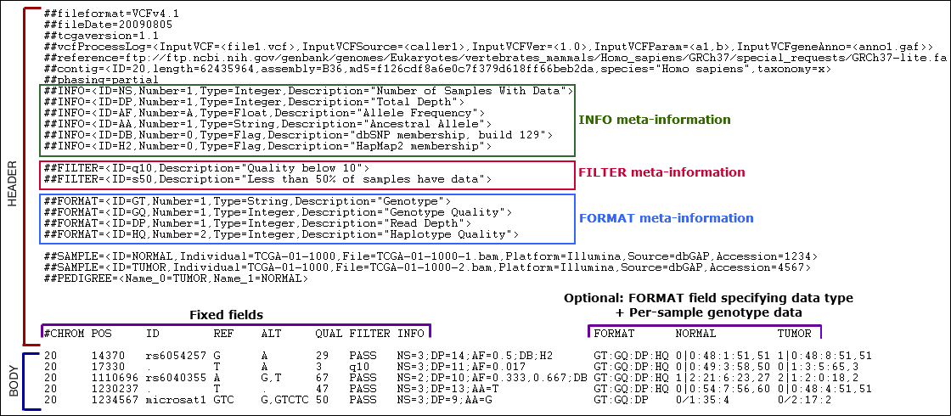
VCF format

Slide 34
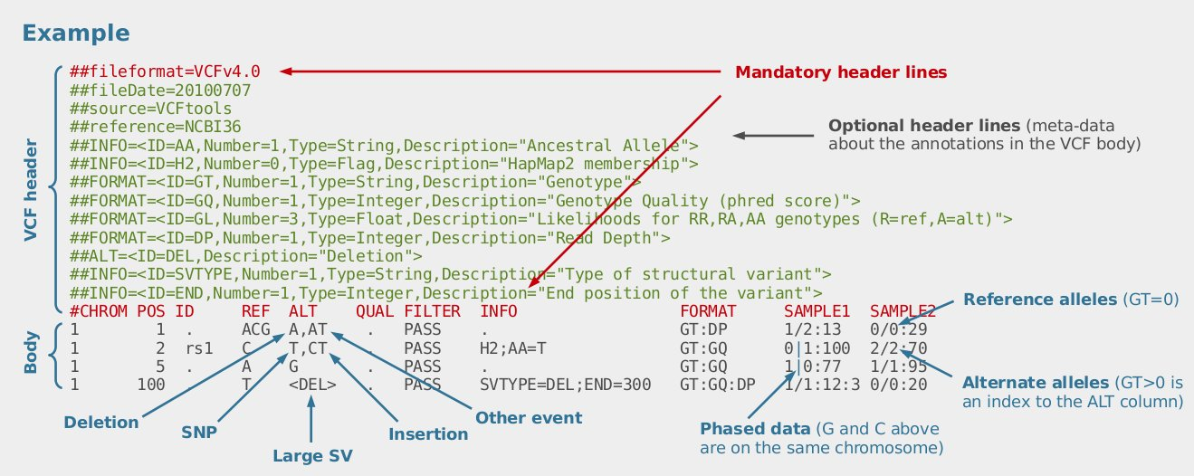
VCF format

Slide 35
VCF lexicon
GT genotypes
GQ genotype quality (PHRED scale)
AD A1,A2: allelic depth
DP total depth (across all samples)
FS Fisher strand bias (PHRED scale)
AF (x,y,z) Allele Frequency for each alternate allele
AC Allelic Count
AN Number of alleles
QD Quality by Depth
DP4: coverage for Ref+,Ref-,Alt+,Alt-
(SS,SSC,…)
Key orders of magnitude
3-5M SNP in the human genome
30-50k in a human exome
1:7 indel:snp ratio in human germlines
Ts/Tv ratio 2-2.1 (~2.8-3 in coding)
somatic variants 0.1/Mb to 100+/Mb

Slide 36
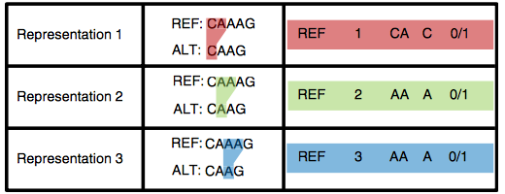
VCF warnings
Krusche et al 2019

Slide 37
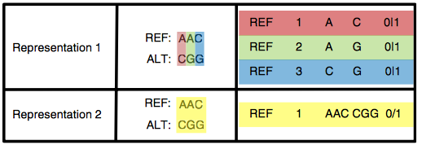
VCF warnings
Krusche et al 2019

Slide 38
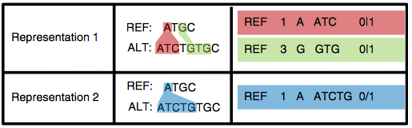
VCF warnings
Krusche et al 2019

Slide 39
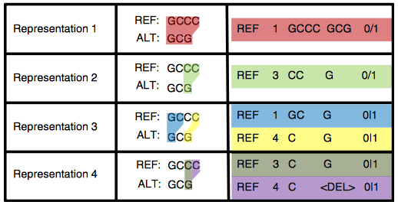
VCF warnings
Krusche et al 2019

Slide 40
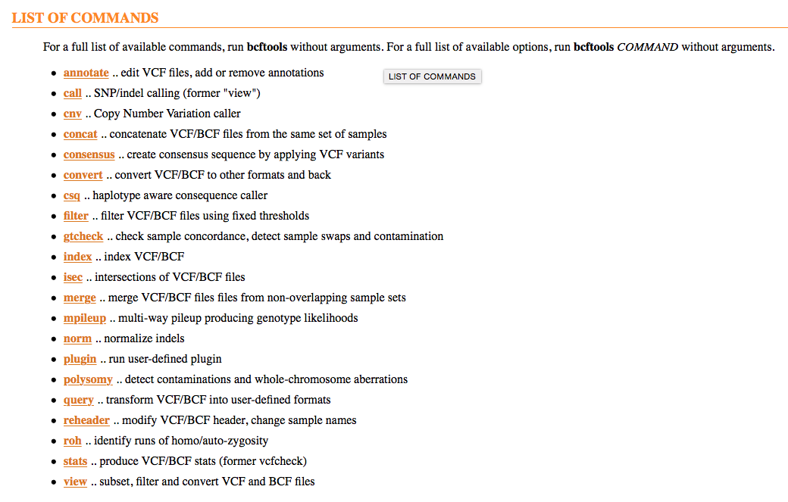
BCFTOOLS

Slide 41
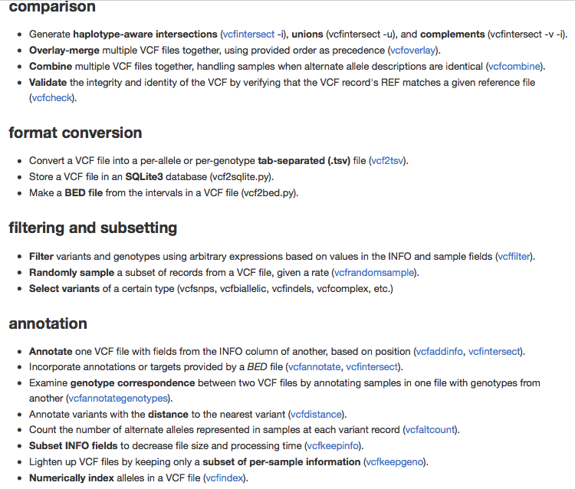
VCFLib

Slide 42
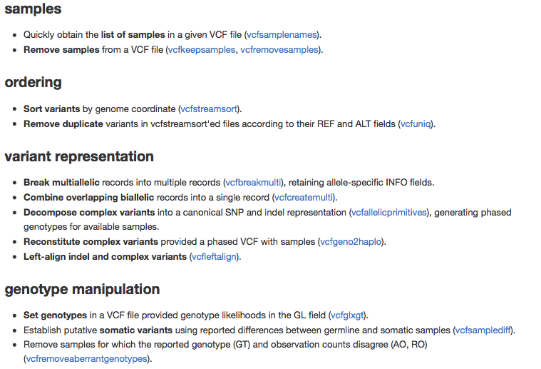
VCFLib

Slide 43
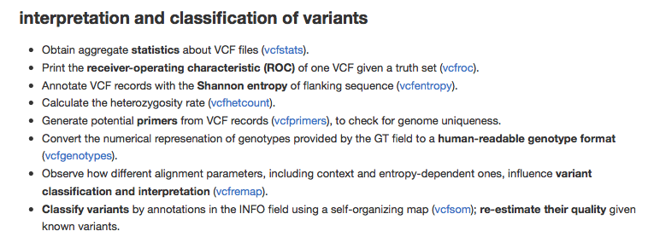
VCFLib

Slide 44
Variant ANNOTATION

Slide 45
Variant Annotation Tools
SNPEff (Broad)
http://snpeff.sourceforge.net
VEP (Sanger)
http://www.ensembl.org/info/docs/tools/vep/index.html
ANNOVAR
http://www.openbioinformatics.org/annovar/
Variant Tools (database / Manipulation)
http://varianttools.sourceforge.net
McCarty et al: http://genomemedicine.com/content/6/3/26

Slide 46
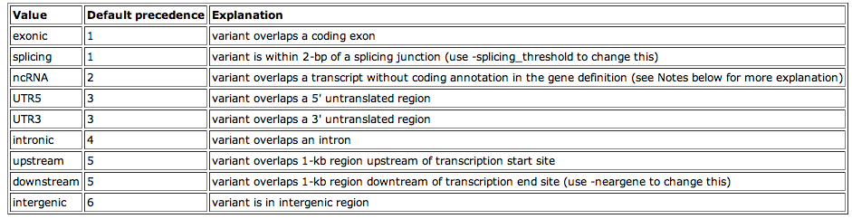
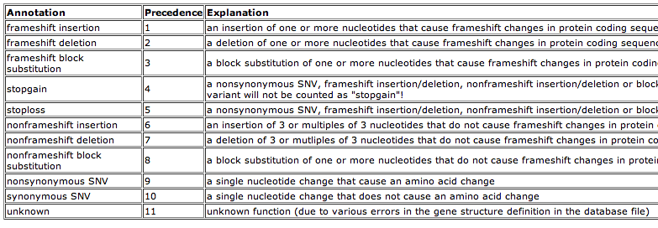
ANNOVAR
exonic_variant_function

Slide 47
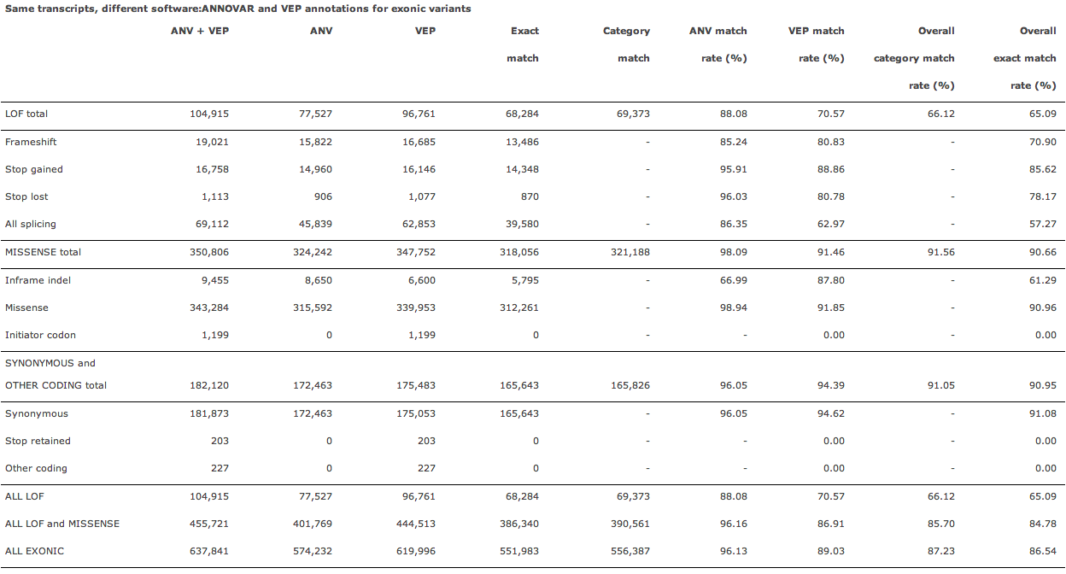
McCarty et al: http://genomemedicine.com/content/6/3/26

Slide 48
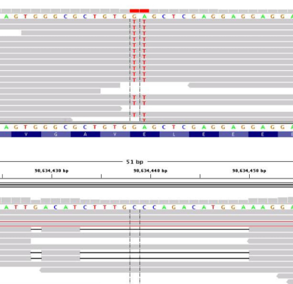
Annotation Challenges
Compensating mutations
DNP or TNP need to be annotated together
Phase of Indels on the same haplotype
Partial effects
Mutation affecting one transcript only
Same gene
Unknown Loss of Function mutations affecting known cancer genes
Adapted from MacArthur et al, 2012

Slide 49
Useful Annotations
dbSNP reference data base for human SNP
dbNSFP pre-annotated database of all substitution in the genome
SIFT pathogenic / deleterious prediction
MutationTaster pathogenic / deleterious prediction
Polyphen pathogenic / deleterious prediction
CADD pathogenic / deleterious prediction
COSMIC database of somatic mutation in cancer
ClinVar interpreted clinically relevant variants (submitted by clinical)
ESP data first large WES project (~3500)
1000G data first large WGS sequencing project (~2000)
ExAC aggregated germline variants from WES (~65k)
GNOMAD aggregated germline variants from WGS & WES (125k + 15k)

Slide 50
GEMINI

Slide 51
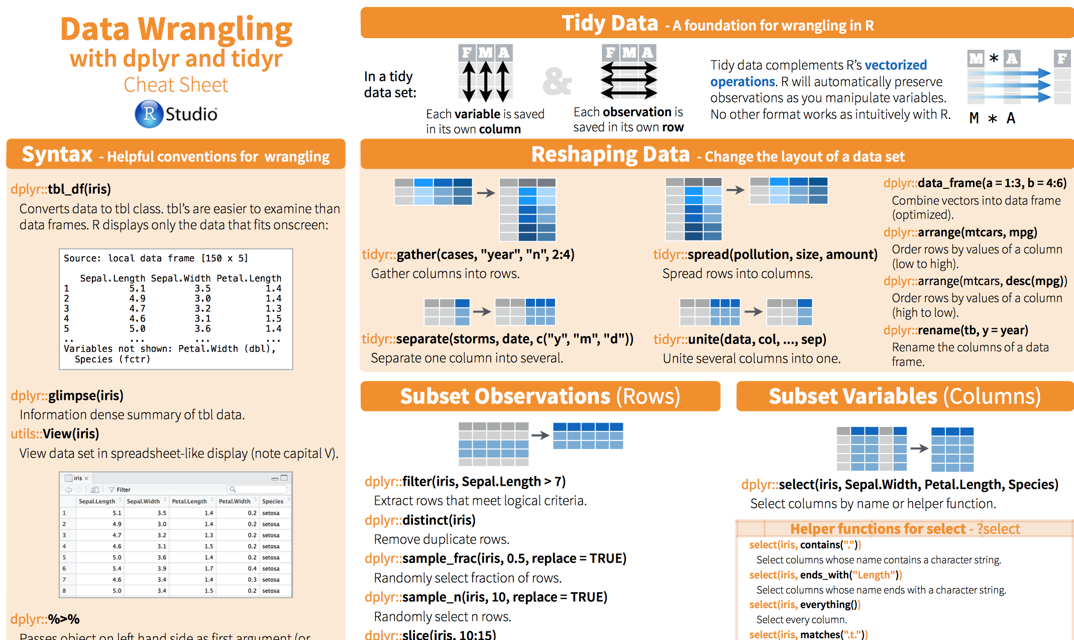
Data wrangling with R
https://rstudio.com/wp-content/uploads/2015/02/data-wrangling-cheatsheet.pdf

Slide 52
Data wrangling with R
%>% pipe
Mutate
Filter
Select
Group_by …. Tally()
Group_by …. summarize(…)
Left_join(dfa,dfb)

Slide 53
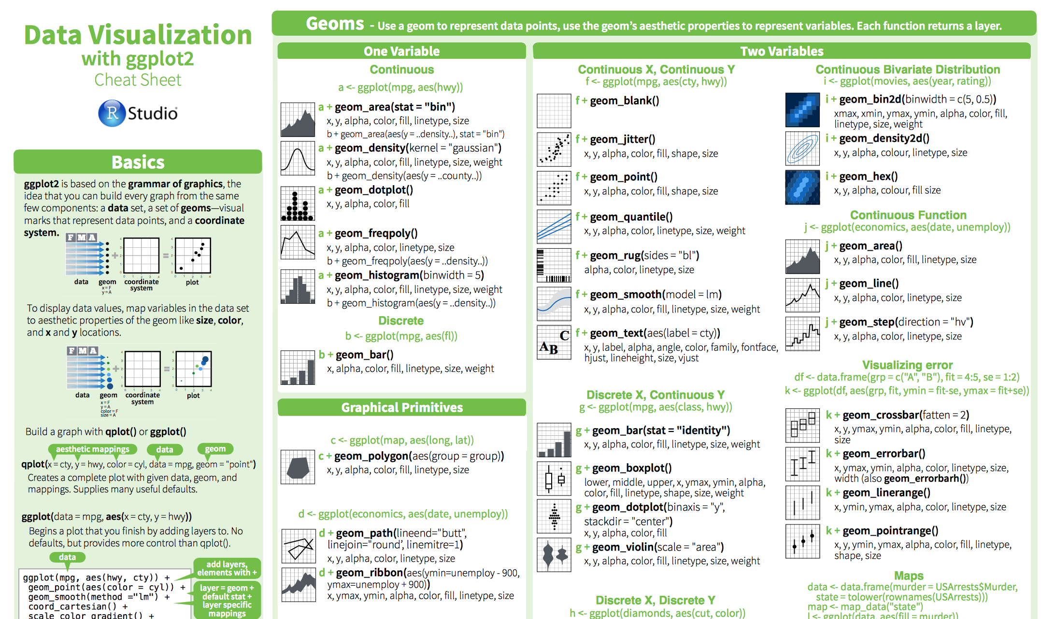
Plotting in R
https://rstudio.com/wp-content%2Fuploads%2F2015%2F03%2Fggplot2-cheatsheet.pdf%2F

Slide 54
Plotting in R
ggplot+
Geom_histogram
Geom_bar / geom_bar(position=“fill”)
Geom_boxplot
Geom_point
Geom_density

